Slide 1
Zhiqian Chen
Assistant Professor
Department of Computer Science and Engineering
Bagley College of Engineering, Mississippi State University
Email: zchen@cse.msstate.edu
Phone: 662-325-1518
imczq.com

Slide 2
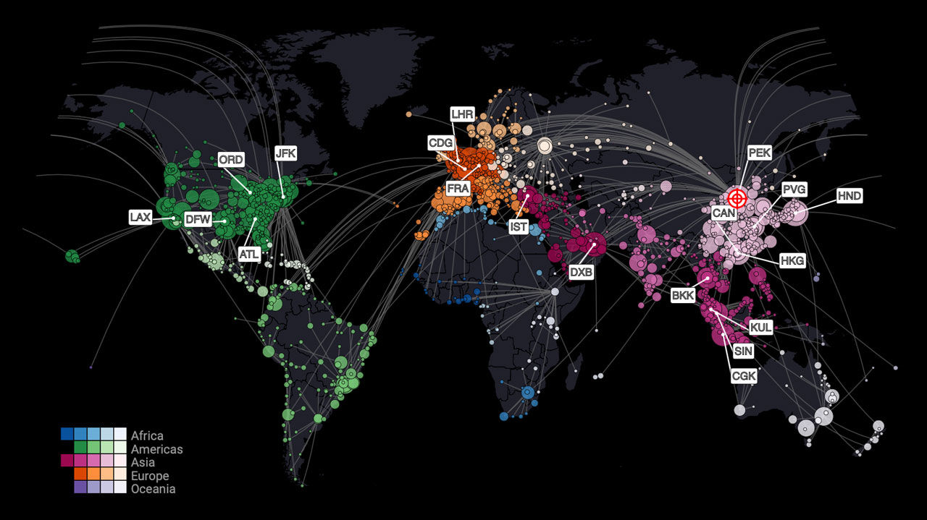

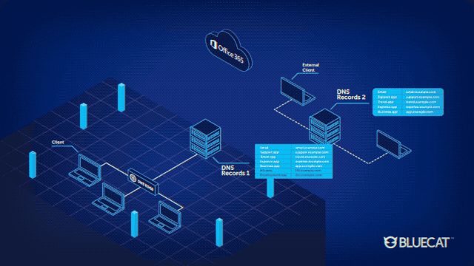
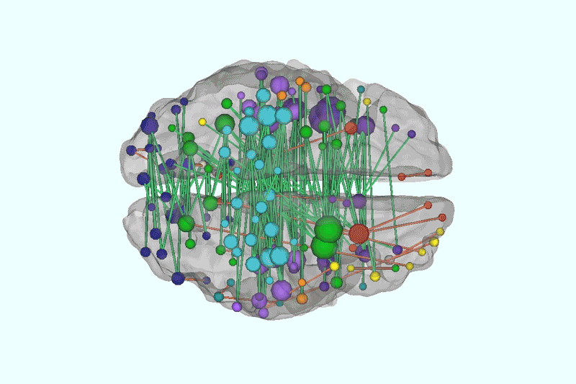
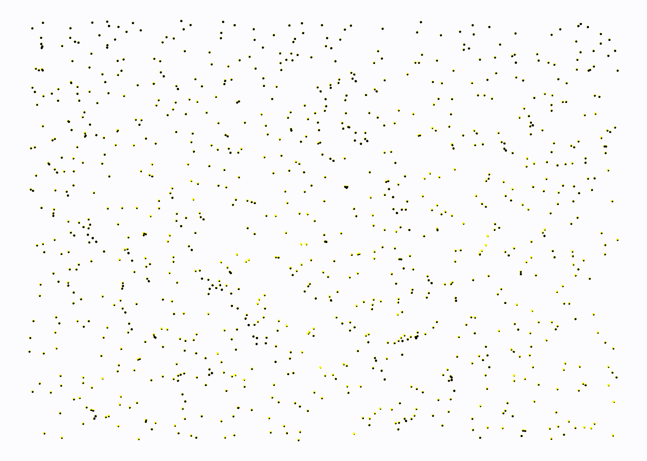
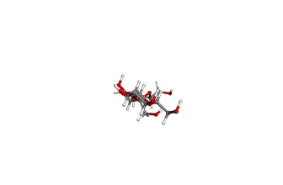
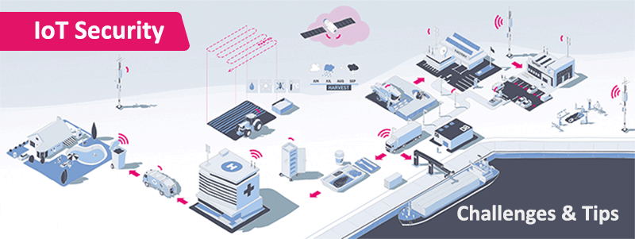
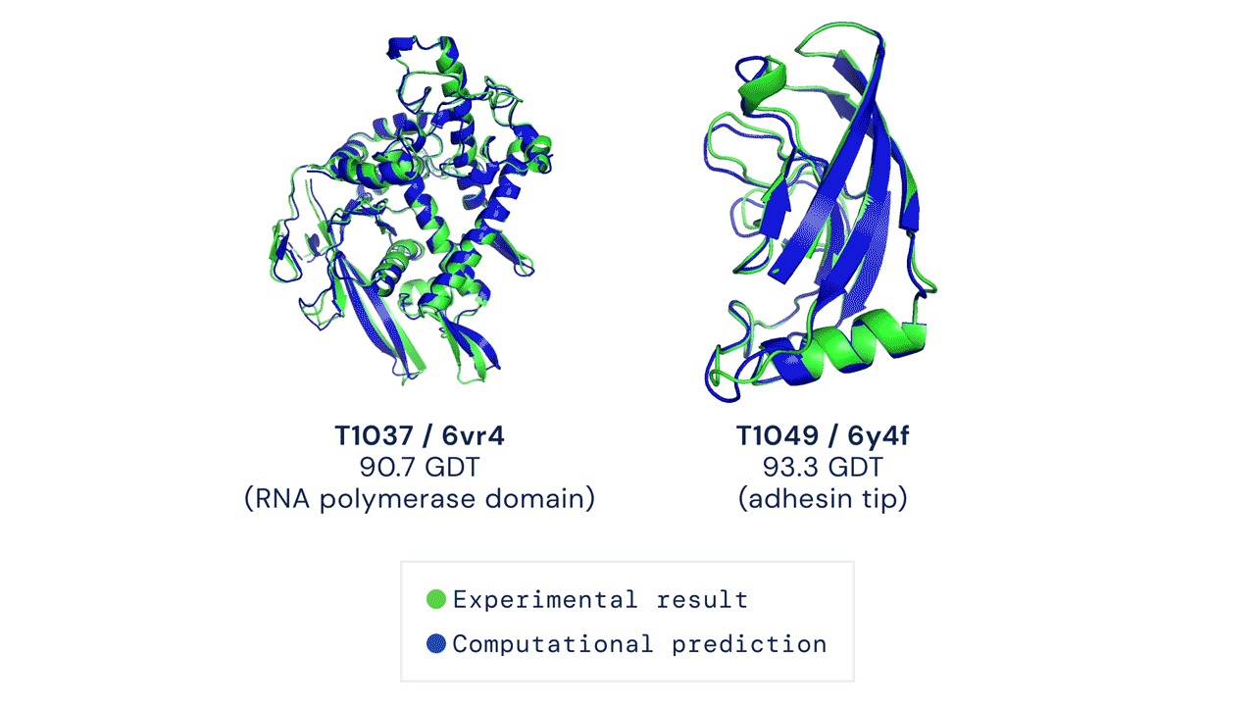
Graph Dynamics are Everywhere
Epidemic
Social Networks
Internet
Brain
Particle System (Physics)
Chemical Structure
Internet of Things
Notes:
Graphs are powerful mathematical abstractions that can describe complex systems of relations and interactions in fields ranging from biology and high-energy physics to social science and economics.

Slide 3
Introduction to the GAI Working Group
The Graph AI Working Group is dedicated to advancing graph machine learning
Focusing on the dynamic propagation on graph and their application in various networks.

Slide 4
Introduction to the GAI Working Group
The Graph AI Working Group is dedicated to advancing graph machine learning
Focusing on the dynamic propagation on graph and their application in various networks.
Analyzing the complexities of multiple interconnected networked systems
rumor
disease

Slide 5
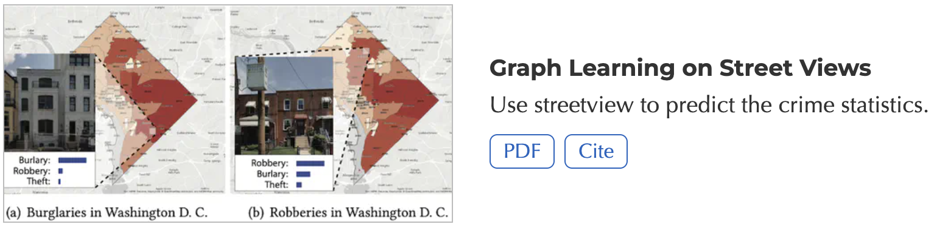
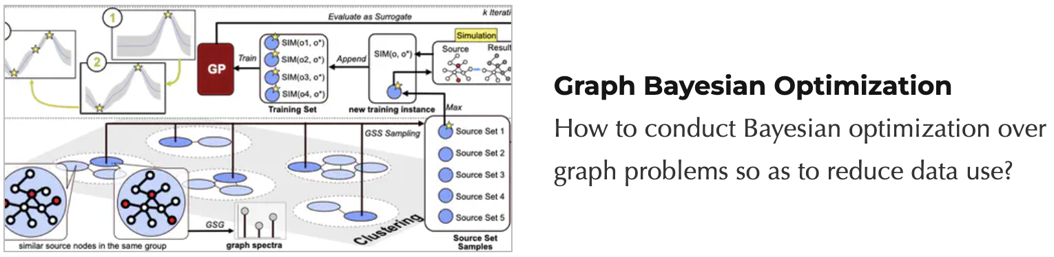
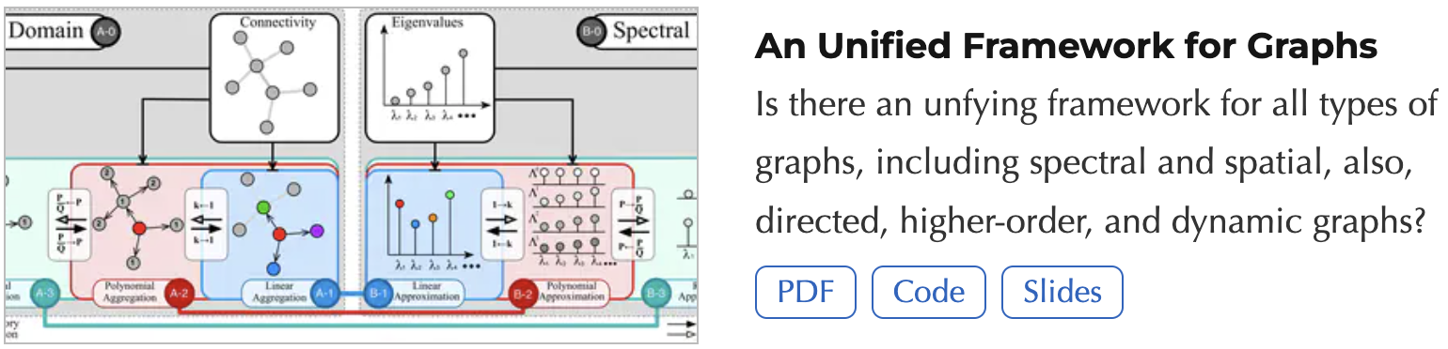
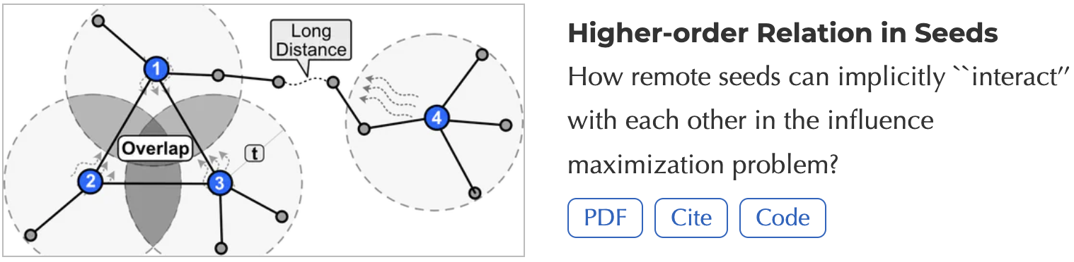
Introduction to the GAI Working Group
Some previous work

Slide 6
Significance of Graph AI in Multi-Layer Networks
Key Challenges: Multi-layer network complexities
Issue 1: real world is a network of networks, however, graph/network in different domain mainly working separately. (Application-wise)
Propose: interaction among multiple network across different domains, such as disease network over human network and rumor over social network

Slide 7
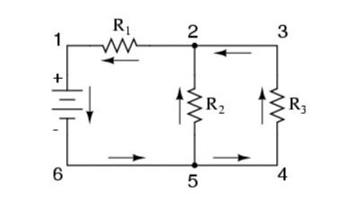
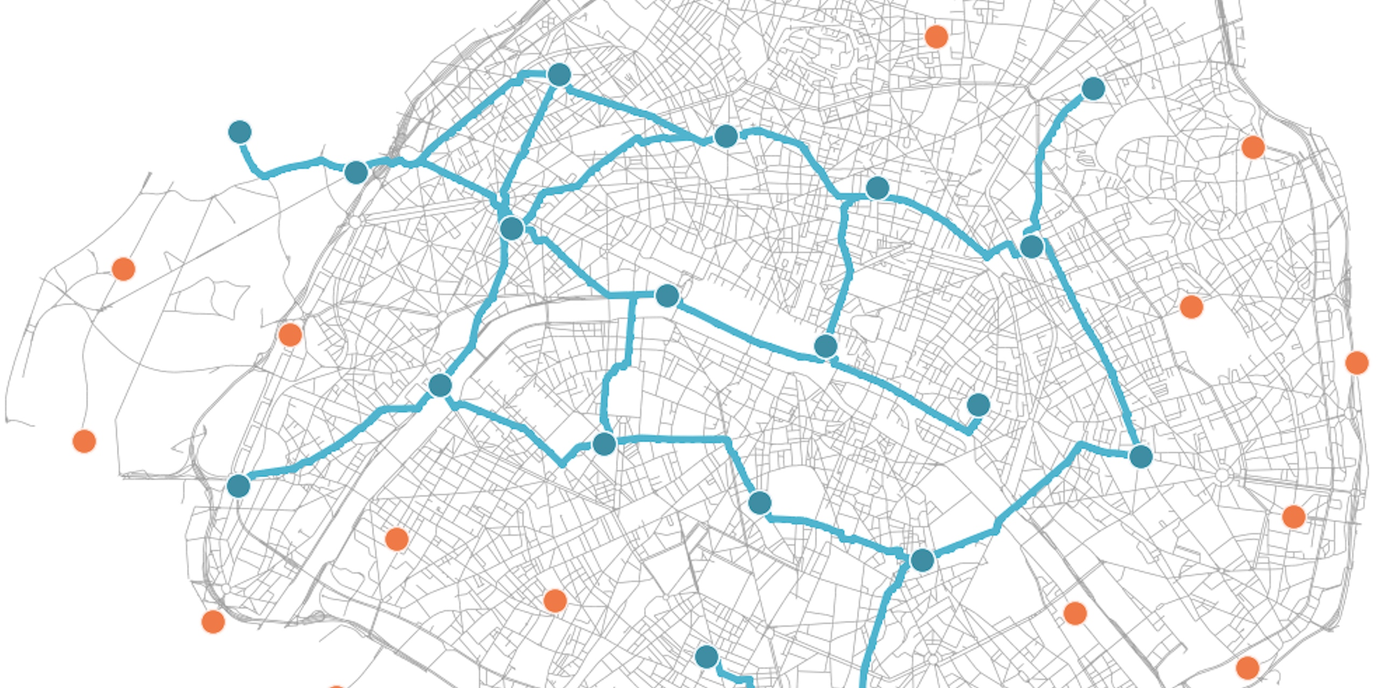
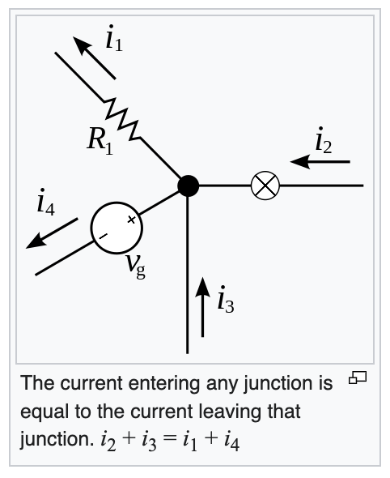
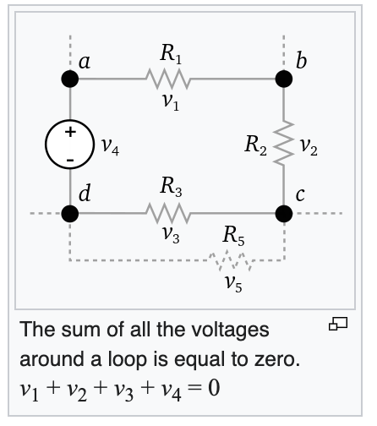

Significance of Graph AI in Multi-Layer Networks
Issue 2: the development of graph theories in each domain is independently, ignoring their similarities and transferability (theory-wise)
Propose: unified theoretical framework to cover most of graph research. For instance, the constraints of current flow in electrical networks by voltage and resistance mirrors the dynamics observed in traffic flow, where the gap in volume between adjacent intersections resembles voltage differences, and the limitations on road capacity are analogous to resistance.

Slide 8
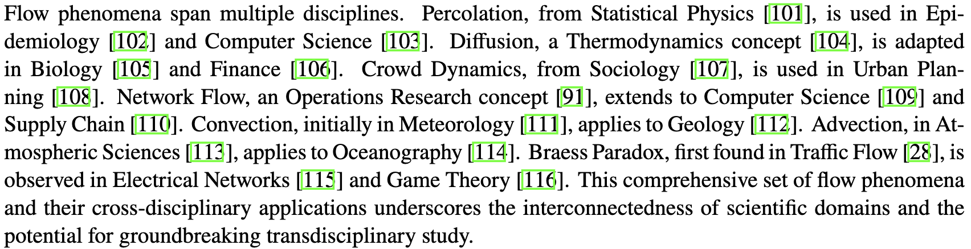
Goals and Impact of the Working Group
Issue 2: the development of graph theories in each domain is independently, ignoring their similarities and transferability
Successful stories: the history of collaborative endeavors across different fields illustrates the potential for synergy

Slide 9
Proposal Grant Opportunities
Opportunities for funding are available across various domains including:
Research Infrastructure
NSF EPSCOR Track 1 and 2, E-RISE RII.
NSF - Community Infrastructure for Research in Computer and Information Science and Engineering (CIRC)
NSF Cyberinfrastructure for Sustained Scientific Innovation (CSSI)
NSF Civil Infrastructure Systems (CIS)
Research Network
NSF Research Coordination Networks
NSF Accelerating Research through International Network-to-Network Collaborations (AccelNet)
NSF GROWING CONVERGENCE RESEARCH (GCR)

Slide 10
GAI WG members
Members:
Zhiqian Chen, Assistant Prof., Computer Science & Engineering
General Graph/Network, dynamic propagation over graphs
Circuit, transportation, social network, epidemiology,
Haifeng Wang, Assistant Prof., Industrial & Systems Engineering
Brain Network
Mohammad Marufuzzaman , Associate Prof., Industrial & Systems Engineering
Logistic Network, supply chain
Megan Ricardson, Assistant Research Prof., Social Science Research Center
Social network
Qingmin Meng, Associate Prof., GeoScience
Geo-spatial network
Ecology network
Inviting more

Slide 11
Planned Activities and Budget
Upcoming Activities:
Preliminary experiments
Collaborative research proposals
Interactive meetings and seminars
Budget Breakdown:
Experiments: $1,000
In-person Seminars: $2,000
Virtual Seminars: $600
Outreach: $500

Slide 12
Q&A
Whom to talk to for cost reimbursement?

